Slide 1
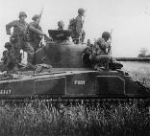
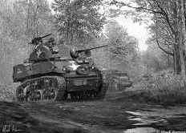
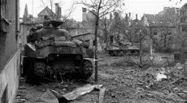
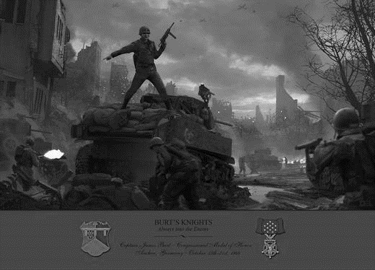
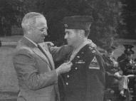
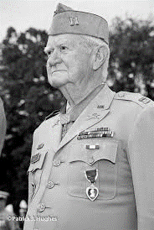
Burt’s Knights Training “Cadillac Don’t Look Back!”
18 May 2020
UNCLASSIFIED
POC- CPT Tyler Kellogg, BN AS3
Tyler.j.Kellogg.mil@mail.mil
As of 4MAY20

Slide 2
7 Minute Drill – BN Training Meeting
Task: Update Burt 6 on Company and Battalion training events.
Purpose: Synchronize all Battalion functions and discuss priorities of training. Disseminate guidance and tasks in real time. Deconflict and synchronize Battalion efforts,
Chair: Burt 3
Frequency: Weekly, Tuesdays at 1000
Roll Call
Burt 1
Burt 2
Burt 4
MEDO
Burt 3
Burt 5
BN MGs
BN FRL
SIGO
BN Training Officer (S3)
BN Schools (S3)
Recorder (S3)
BN FSO
Chaplain
BMO
Able 6/7
Black Knight 6/7
Cobra 6/7
Highlander 6/7
Gunslinger 6/7
Burt 6
Burt 7
Burt 5
Burt 3
Burt 37
Inputs
Training Calendar (MAC / LRTC
LOGSTAT
Running Estimates
DIV / BDE Mission and intent
BN METL
Company Training Stats
Company Stretch Goals
BN Maintenance Focus
BN Schools update
Outputs
Burt 6 Priorities and guidance
Approved T+6 training schedule
Shared understanding of the BN training plan from T+0 - T+6, T+7 -T+11, T+12 - T+16.
Agenda
COVID-19 Update – S2 / MEDO / S4
CG near term priorities
1/1ID / 3-66AR Mission and Intent
BN METL Assessment
T+0 – T+6 Review
Company Training
Stretch Goals
T7 – T16 Review
Command Maintenance Focus
Schools
Alibis/Final Comments
POC- CPT Tyler Kellogg, BN AS3
Tyler.j.Kellogg.mil@mail.mil
CAO 18 MAY20

Slide 3
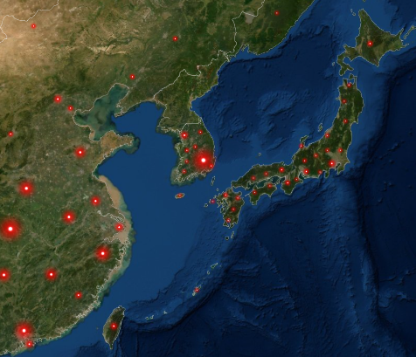






COVID-19 Update: PTDO Area of Interest
Assessment: In the event of a potential humanitarian deployment to the Korean Peninsula post-DPRK regime change, commanders should integrate COIN-era lessons learned into their dealings with potentially Chinese-compromised NGOs and aid organizations. Beijing’s increased support to the institutions of international order both seek to challenge the US role as global hegemon, and utilize the proximity of defacto cooperation to enable placement and access for collection and influence campaigns.
Open Source Highlights – US Army Asian Studies Detachment
North Korea:
N. Korean Paper Calls For Strong Belief In Own Power Amid Sanctions, Global Pandemic
Yonhap News (05/18/2020)
South Korea
S. Korea, China, Japan Agree To Boost Cooperation On Coronavirus
Yonhap News (05/15/2020)
China:
China seals off cities near North Korea as new coronavirus clusters grow
The Seattle Times (05/18/2020)
PLA Shares Experience In COVID-19 Fight With Militaries From Multiple Countries
Xinhuanet (05/17/2020)
China Supports UN, WHO Playing Due Roles In Global Anti-Epidemic Cooperation: Xi
Xinhuanet (05/15/2020)
Total | % Pop. | Deaths | % Deaths
290,678 | 0.20% | 2,722 | 0.9%
84,054 | 0.01% | 4,638 | 5.5%
16,285 | 0.01% | 744 | 4.6%
11,065 | 0.02% | 263 | 2.4%
UNK | UNK | UNK | UNK
440 | 0.00% | 7 | 1.6%
Sources: Johns Hopkins University COVID-19 Dashboard: (https://coronavirus.jhu.edu/map.html)
POC- CPT Taylor Mextorf, BN S2
taylor.j.mextorf.mil@mail.mil
As of 18MAY20

Slide 4
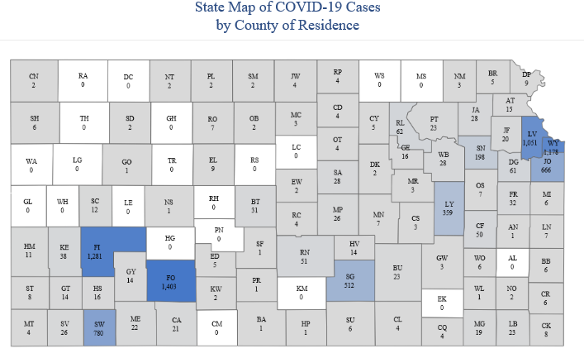
COVID-19 MEDCOP
 | Confirmed Cases | Deaths | Recovered
FRKS (100mi Rad) | 913 | - | -
Kansas | 8,340 | 173 | -
U.S. | 1,537,830 | 90,694 | 288,842
Global | 4,786,672 | 317,695 | 1,776,641
Location | HPCON Level
Ft Riley | C
Ft Leavenworth | C
McConnell AFB | C
Kansas Testing Sites
- KDHE-Topeka
BAS Hours | Hotlines
Sick Call 0545-0630 | Duty Hours 785-239-DOCS Option 7
Walk-In Hours 0930-1700 | After duty hours 1-800-TRICARE
IACH
Isolation Beds | 5
Ventilators | 6
LAST 24hrs: Working within the COVID-19 protocol to improve MEDPROS numbers for the BN, working to support Red Cycle taskings.
Next 24 hrs: -continue daily reporting of patient status and tracker - continue running inventories of critical supplies - daily T2T status reporting for medical personnel.
POC- 1LT Charles Cook Medo
Charles.l.cook24.mil@mail.mil
As of 18May20

Slide 5
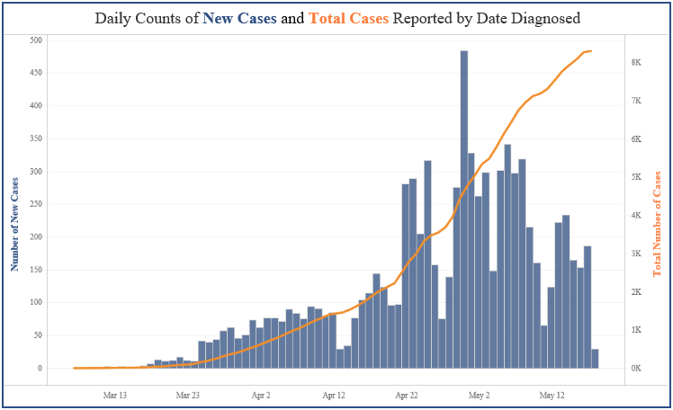
COVID-19 DAILY RATE (KANSAS)
KANSAS STATE STAY AT HOME ORDER ISSUED 30MAR20
POC- SFC Charles Griffith, BN MED PSG
Charles.a.griffith.mil@mail.mil
As of 05MAY20
POC- 1LT Charles Cook Medo
Charles.l.cook24.mil@mail.mil
As of 18May20

Slide 6
3-66AR S4 LOGSTAT
CL II Materiel | TYPE | QTY PER | O/H QTY | AVG EXP. | HIGH EXP. | Gained | DOS
Paper Towels | BX | 16 | 192.3 boxes | 16 packs | 33 packs | 0
GOJO Hand Soap (12 oz) | EA | 1 | 307 | 15 | 17 | 0
GOJO Hand Soap (gal) | EA | 1 | 14.25 | 2 gal | 4.5 | 0
Hand Sanitizer (12 oz) | EA | 1 | 297 | 3 | 5 | 0
Hand Sanitizer (4 oz) | EA | 1 | 155 | 0.6 | 2 | 0
Bleach (1 gal) | EA | 1 | 64.7 | 1 gal | 1.5 gal | 0
Trash Bags | BX | 30 | 417 boxes | 9 bags | 15 bags | 0
Disinfecting Wipes | EA | 1 | 58 | 1/10 tub | 2/10 tub | 0
Lysol/Disinfecting Spray | EA | 1 | 19 | 1/8 | 1/8 | 0
Clorox/Disinfectant Spray | EA | 1 | 41 | / | / | 0
CL III
MOGAS (5 gal) | EA | 4 | 10.2 gal | 1.0 gal | 1.5 gal | 0
CL II Materiel | A Co. | B Co. | C Co. | FSC | HHC | BN
Paper Towels
GOJO Hand Soap
Hand Sanitizer (12fl oz)
Hand Sanitizer (4 oz)
Bleach (1 gal)
Trash Bags
Disinfecting Wipes
Lysol/Disinfecting Spray
v
Consumable
Green | 15 days <
Amber | 4-14 days
Red | 1-3 days
Black | NONE
1LT Harrington, Brendan R., S4
brendan.r.harrington.mil@mail.mil
As of: 19MAY20

Slide 7
3-66 AR Shortages
COMPANY | SHORTAGES | QTY ON ORDER | PERCENT ON ORDER
A CO | 474 | 439 | 92%
B CO | 261 | 258 | 98%
C CO
G FSC | 1488 | 1449 | 97%
HHC | 2180 | 1980 | 90%
1LT Harrington, Brendan R., S4
brendan.r.harrington.mil@mail.mil
As of: 18MAY20

Slide 8
CG Near-Term Priorities
People First
COVID-19 Response. Implement measures to prevent and reduce transmission of COVID-19. Support our Soldiers, Civilians, Families, and local community as we work through this pandemic. Over-communicate risk factors and mitigation measures as we navigate through this dynamic situation. Proactively identify issues and provide support to the greatest extent possible. Enforce compliance with installation access procedures, increased sanitation measures, social distancing, and other published directives. Reference the following web pages for up to date and accurate information:
Fort Riley’s FaceBook Page: https://www.facebook.com/FortRiley
1st Infantry Division’s FaceBook Page: https://www.facebook.com/1stInfantryDivision
Irwin Army Community Hospital’s FaceBook Page: https://www.facebook.com/IrwinArmyCommunityHospital
Build Cohesive, Resilient Units and Families. Sponsor, receive, and integrate our new Soldiers and Families to the Fort Riley Team—carefully manage summer transitions to reduce turbulence. Embrace This is My Squad and improve our ability to identify and act when a teammate is struggling. Build the confidence and competency of our junior leaders, empowering them to ‘Lead on Day One’—maximize enrollment in functional schools (MG, CLC, BFV LC, MLMC) and ensure timely enrollment in Professional Military Education. Foster command climates that inspire Soldiers to continue their service to our Nation. Encourage and support initiatives that build resiliency. Provide access to safe, secure, and quality homes and barracks.
Predictability. Enforce strict training management, publish, and adhere to training schedules forecasting to T-4 weeks and LRTCs depicting major events to T-6 months in order to reduce stress on the force and maximize opportunities for training reps and sets. Focus on detailed weekly battalion training and training resource meetings, MDMP/TLPs, and adhere to unit battle rhythms—use the 8-Step training Model and apply the BRO BIG 9. Allocate and protect time for BRO Leader’s Training. Commanders at echelon are responsible for training: capitalize on installation resources and develop subordinates for future positions (Build The Bench). Unit leaders will schedule time for maintenance and deliberate recovery as a part of unit training plans (PMCS, Services, AOR, Command Maintenance).
Readiness, Modernization, Reform
Build Combat Power. 90% OR on all ground fleet pacing items (75% Aviation Systems) and JCR/JBC-P systems. Execute routine tasks routinely: complete FLIPLs under 30 days, maintain equipment at 10/20, no recoverables over 20 days, adhere to BRO Motorpool/Rollout standards, and complete pay and personnel actions according to regulation. Focus on fulfilling 95% of Battalion CDDP, CSDP, and CMDP certification requirements. Continue to reform our systems that build combat power: establish a culture of personal ownership of equipment, pride in unit areas, and a holistic health and fitness program aimed at the individual Soldier.
Prepare For Large Scale Combat Operations. Build lethality through mastery of the fundamentals—Shoot, Move, Communicate, and Medicate. Set conditions for the Division to capitalize on WFX 20-05 and NTC 20-10 in preparation for WFX 21-03—focus on enhancing our digital lethality (Mission Command Digital Master Gunner, Signal Master Gunner) and our ability to sustain at distance. Integrate and exploit new technologies in training (FTUAS, JAB, ENVG).
Winning Matters!
Support Global Requirements. Operationalize 1ID FWD’s support to DEFENDER 20, focus on strengthening interoperability with our Allies and Partners. Deliberately transition control of OAR to 1CD through a detailed handover that captures 24 months of experience and sustains readiness in USAREUR. Support world-wide deployments in support of Combatant Commander requirements (2/1ABCT, 1CAB, and 1SB).
UNCLASSIFIED//FOUO
COL Lambert, Kevin (Chief of Staff)
Kevin.j.lambert4.mil@mail.mil
As of: 17 1200 MAR 2020

Slide 9
1ABCT Mission and Intent
Mission: During FY20, the Devil Brigade builds and maintains combat ready forces capable of deploying worldwide to win in complex environments.
Commander’s Intent:
Purpose: Protect the United States and its interests at home and abroad.
Key Tasks:
Master individual SM tasks and drills, collective tasks, and METs through multi-echelon training.
Develop and certify leaders (Bro Big 9, Staff Rides, OPD/NCOPD, PRT, Range OICs, OPTs, BRO Time Training).
Build resilient Soldiers/families (family re-integration, sponsorship, incentives).
Conduct deliberate recovery operations after field training and maintain an OR rate of 90%.
Sustain the organization’s momentum improving systems and transferring lessons learned to new Devils.
End State:
Friendly: 1ABCT Soldiers/families experience bolstered resilience/prepared to conduct field training. 1ABCT units are certified with six months of CO qualifications and prepared to conduct BN level missions during Brigade training exercises.
Enemy: Peer and near-peer adversaries view the Devil Brigade as a trained and ready fighting force.
Terrain: FRKS ranges returned to pre-exercise conditions and able to host follow-on training for FRKS units.
Civilian: FRKS community not impacted by 1ABCT training exercises. Emphasis on family readiness and teamwork strengthens our communities.
POC- CPT Tyler Kellogg, BN AS3
Tyler.j.Kellogg.mil@mail.mil
As of 4MAY20

Slide 10
Commanders Intent 3QFY20
MISSION: Burt’s Knights close with and destroy enemy forces using fire, maneuver, and shock effect, or to repel his assault by fire and counterattack.
COMMANDER’S INTENT
PURPOSE Prepare the Burt’s Knights for the Brigade PTDO mission beginning OCT2020 while mitigating COVID risk Soldiers and their families.
KEY TASKS
Qualify 100% of Tank, Bradley, and Mounted Machine Gun Platform Crews
Certify Squads and Platoons on KCTs prior to Platoon LFX
Operationalize FRKS COVID tasks to Protect Soldiers, Families and Civilians on FRKS
Be Engaged Leaders at all times; Know your Team; set, live and enforce Standards
Build Readiness through a culture of maintenance management (MTW, recovery, PMCS, LPDs)
ENDSTATE
3-66 Armor Regiment Soldiers are a tenacious, lethal team of Professionals; Tactical and technical experts able to fight and win against any enemy, any time, any place; Resilient members of the community, bound to our commitment to Family, Country, the Army, and our fellow Brothers & Sisters in Arms. When Knights and their Families depart our team, they will have the experience required for continued success in our Army.

Slide 11
BN METL Assessment
Mission Essential Tasks | 3rd / 4th QTR / FY 20
 | End of Stay at home order | STAFFEX | CPX / DG2A/B | Crew Gunnery | End of 3rd QTR FY 20 | PLT LFX
(07-BN-1028) Conduct an Area Defense | T- | T- | T- | T- | T- | T
(07-BN-1072) Conduct a Movement to Contact | T- | T- | T- | T- | T- | T
(07-BN-1092) Conduct an Attack | T- | T- | T- | T- | T- | T
(07-BN-1272) Conduct Area Security | T- | T- | T- | T- | T- | T
(55-BN-4800) Conduct Expeditionary Deployment Operations | T | T | T | T | T | T
POC- CPT Tyler Kellogg, BN AS3
Tyler.j.Kellogg.mil@mail.mil
As of 4MAY20

Slide 12
Training Review
Burt’s Knights
(T+0 – T+6 Review)
POC- CPT Tyler Kellogg, BN AS3
Tyler.j.Kellogg.mil@mail.mil
As of 4MAY20
Notes:
BN submit Mission Statement

Slide 13
T+0 (TW 34)
18 May
19 May
20 May
21 May
22 May
23 May
24 May
MONDAY
TUESDAY
WEDNESDAY
THURSDAY
FRIDAY
SATURDAY
SUNDAY
Notes:
Week 3/4 of Battle Rhythm
Focus Areas within the Commander’s Priorities:
Command Maintenance Focus (Week 3):
-Tentage / Containers / Deployment Equipment
BN Training Focus:
-STAFFEX
-Small Arms Density
BDE
COVID – 19 Response
Stay at home order rescinded
Land Conference
BDE CUA
DONSA
Memorial Day
OPS Sync
BDE Plans Update
PTDO
BN
COVID – 19 Response
Staff Sync
Training Meeting
TRSM
STAFFEX
MA
Command Maint.
M4 Range ( Able)
SoTW due to BN
Able
HHC LPD (Fires)
M4 Range
(Highlander)
M4 Range ( Black Knights)
M4 Range ( Cobra)
BN Sensing Session
LTs - 2 per CO
MG Range ( Highlander)
STAFFEX Conditions Check
BN Sensing Session
PV2-SPC - 2 per CO
G Co COR
SITREP due to BDE
STAFFEX
Gather the Tools
Training Meeting Slides Due
CDR’s Priorities:
Vehicle, Weapon, and Equipment Services
Training and Operational Obligations
Organizational Inspection Program
Deployment and Personnel Readiness
HHC
M4 Range
MG Range
A Co
M4 Range
B Co
M4 Range
M4 Range
C Co
M4/MMG Range
MMG Range
G Co
STBY Fuel Retail
Legend: Added Removed Changed Tentative
BN Meeting
Staff meeting
RANGES
BN Training
BDE Training
Services
POC- CPT Tyler Kellogg, BN AS3
Tyler.j.Kellogg.mil@mail.mil
As of 18MAY20
Notes:
BN submit Mission Statement

Slide 14
T+1 (TW 35)
25 May
26 May
27 May
28 May
29 May
30 May
31 May
MONDAY
TUESDAY
WEDNESDAY
THURSDAY
FRIDAY
SATURDAY
SUNDAY
Notes:
Week 4/4 of Battle Rhythm
Focus Areas within the Commander’s Priorities:
Command Maintenance Focus (Week 4):
-Tentage / Containers / Deployment Equipment
BN Training Focus:
-Staffex
-Gunnery TBL II
-Small Arms Density
-MTN Terrain Walk RXL
-Change of Command Inventories
BDE
COVID – 19 Response
DONSA
Memorial Day
OPS Sync
BDE CUA
OCT Academy
1-16 GT III
BN
Gunnery
STAFFEX
Scout TBL III with 1-16th IN
BN EST Density – EST #1
BN EST Density – EST #3
GST Training
TBL 2 BATS / AGTS
Training Meeting
M17 Range
(Highlander)
M17 Range
(Able)
BN Sensing Session
SGT-- 2 per CO
M17 Range
(Cobra)
TRSM
Maint. Terrain Walk RXL
Staff Sync
Maint. Terrain walk RXL
Command Maint.
Command and Staff
CDR’s Priorities:
Vehicle, Weapon, and Equipment Services
Training and Operational Obligations
Organizational Inspection Program
Deployment and Personnel Readiness
HHC
M17 Range
A Co
Command Maint.
M17 EST
M17 Range
B Co
C.O.C Inventories
C Co
M17 Range
GST Prep
GST Prep
SQD Competition
G Co
Legend: Added Removed Changed Tentative
BN Meeting
Staff meeting
RANGES
BN Training
BDE Training
Services
POC- CPT Tyler Kellogg, BN AS3
Tyler.j.Kellogg.mil@mail.mil
As of 18MAY20
Notes:
BN submit Mission Statement

Slide 15
T+2 (TW 36)
1 June
2 June
3 June
4 June
5 June
6 June
7 June
MONDAY
TUESDAY
WEDNESDAY
THURSDAY
FRIDAY
SATURDAY
SUNDAY
Notes:
Week 1/4 of Battle Rhythm
Focus Areas within the Commander’s Priorities:
Command Maintenance Focus (Week 1):
-Communications
BN Training Focus:
-M17 /M4 Range Density
-TBL 2 / M1+M2 -GST/VCE
-BDE Maint. Terrain Walk
BDE
COVID – 19 Response
1-16 GT III-VI
BN
Gunnery
TBL 2 BATS / AGTS
Scout TBL IV-VI with 1-16th IN
A Co COC
M17 Range
(Highlander)
BN TARP Brief (Distributed)
M4 Range
(Gunslinger)
Staff Sync
Training Meeting
TRSM
SoTW due to BN
SITREP due to BDE
Command Maint.
Maint. Terrain Walk.
BN Board
USR Brief (est)
Bradley GST
Tank GST
Tank VCE
Bradley VCE
CDR’s Priorities:
Vehicle, Weapon, and Equipment Services
Training and Operational Obligations
Organizational Inspection Program
Deployment and Personnel Readiness
HHC
RANGES
A Co
Command Maint.
Tank VCE
Tank GST
B Co
C Co
GST Training
GST Testing
GST Testing
G Co
Legend: Added Removed Changed Tentative
BN Meeting
Staff meeting
RANGES
BN Training
BDE Training
Services
POC- CPT Tyler Kellogg, BN AS3
Tyler.j.Kellogg.mil@mail.mil
As of 18MAY20
Notes:
BN submit Mission Statement

Slide 16
T+3 (TW 37)
8 June
9 June
10 June
11 June
12 June
13 June
14 June
MONDAY
TUESDAY
WEDNESDAY
THURSDAY
FRIDAY
SATURDAY
SUNDAY
Notes:
Week 2/4 of Battle Rhythm
Focus Areas within the Commander’s Priorities:
Command Maintenance Focus (Week 2):
-CBRN / OCIE
BN Training Focus:
TBL III CPC
HETT Movement 14 June
BDE
COVID – 19 Response
BDE Commex DG-II
BN
Gunnery
COMMEX DG-II
TBL 2 MTC – BATS / AGTS
TBL III CPC
Command Maint.
Staff Sync
TRSM
CMD & Staff
HETT Movement to Douthit
Gunnery LPD
OCT Academy
CDR’s Priorities:
Vehicle, Weapon, and Equipment Services
Training and Operational Obligations
Organizational Inspection Program
Deployment and Personnel Readiness
HHC
COMMEX
A Co
RECOVERY Scouts
GT III
B Co
C Co
BFV GT III
G Co
Legend: Added Removed Changed Tentative
BN Meeting
Staff meeting
RANGES
BN Training
BDE Training
Services
POC- CPT Tyler Kellogg, BN AS3
Tyler.j.Kellogg.mil@mail.mil
As of 18MAY20
Notes:
BN submit Mission Statement

Slide 17
T+4 (TW 38)
15 June
16 June
17 June
18 June
19 June
20 June
21 June
MONDAY
TUESDAY
WEDNESDAY
THURSDAY
FRIDAY
SATURDAY
SUNDAY
Notes:
Week 3/4 of Battle Rhythm
Focus Areas within the Commander’s Priorities:
Command Maintenance Focus (Week 3):
-Maintenance Focus:
Weapons / Optics / NVGs
BN Training Focus:
TBL III CPC
-AAC Range / LFAST
-DGIIA
-Movement to Douthit
BDE
COVID – 19 Response
FTX DG IIA
BN
Gunnery
FTX DG IIA (STAFFEX)
TBL III CPC
HETT Movement to Douthit
AAC’s Scrn RG
LFAST
Occupy Douthit
TBL IV & V DMPTR
Command Maint.
Training Meeting
TRSM
SoTW due to BN
SITREP due to BDE
Motorcycle Safety Ride (TBP)
Staff Sync
CDR’s Priorities:
Vehicle, Weapon, and Equipment Services
Training and Operational Obligations
Organizational Inspection Program
Deployment and Personnel Readiness
HHC
OPFOR SUPPORT Scout PLT
A Co
HETT Movement to Douthit
AACs, P&S, Boresight
LFAST
GT IV
B Co
C Co
MMG GT III
BFV GT IV
BFV GT V
G Co
Gunnery Prep
Legend: Added Removed Changed Tentative
BN Meeting
Staff meeting
RANGES
BN Training
BDE Training
Services
POC- CPT Tyler Kellogg, BN AS3
Tyler.j.Kellogg.mil@mail.mil
As of 18MAY20
Notes:
BN submit Mission Statement

Slide 18
T+5 (TW 39)
22 June
23 June
24 June
25 June
26 June
27 June
28 June
MONDAY
TUESDAY
WEDNESDAY
THURSDAY
FRIDAY
SATURDAY
SUNDAY
Notes:
Week 4/4 of Battle Rhythm
Focus Areas within the Commander’s Priorities:
Command Maintenance Focus (Week 4):
-Tentage
-Containers
BN Training Focus:
-AAC Range / LFAST
-DGIIA
BDE
COVID – 19 Response
FTX DG IIA AAR
FTX DG IIB
BN
Gunnery
TBL IV & V DMPTR
Red Cycle RIP
Training Meeting
Staff Sync
Command Maint.
TRSM
Command and Staff
FTX DG IIA
CDR’s Priorities:
Vehicle, Weapon, and Equipment Services
Training and Operational Obligations
Organizational Inspection Program
Deployment and Personnel Readiness
HHC
CPX
A Co
B Co
C Co
BFV GT VI
MMG GT V
G Co
TBL IV & V DMPTR
Legend: Added Removed Changed Tentative
BN Meeting
Staff meeting
RANGES
BN Training
BDE Training
Services
POC- CPT Tyler Kellogg, BN AS3
Tyler.j.Kellogg.mil@mail.mil
As of 18MAY20
Notes:
BN submit Mission Statement

Slide 19
T+6 (TW 40)
29 June
30 June
01 July
02 July
03 July
04 July
05 July
MONDAY
TUESDAY
WEDNESDAY
THURSDAY
FRIDAY
SATURDAY
SUNDAY
Notes:
Week 1/4 of Battle Rhythm
Focus Areas within the Commander’s Priorities:
Command Maintenance Focus (Week 1):
-Communication
BN Training Focus:
-FTX DG IIB
-TBL IV & V DMPTR
-Red Cycle RIP
-MORTEP Train up
BDE
COVID – 19 Response
FTX DG IIB
FTX DG IIB AAR
BN
TBL IV & V DMPTR
Range Cleanup / AAR
MORTEP Train-Up
Gunnery Redeployment Window
Red Cycle RIP
Command Maint.
Training Meeting
TRSM
Staff Sync
Assume Red Cycle
CDR’s Priorities:
Vehicle, Weapon, and Equipment Services
Training and Operational Obligations
Organizational Inspection Program
Deployment and Personnel Readiness
HHC
MORTEP Train-Up
A Co
Gunnery Redeployment Window
B Co
C Co
G Co
Legend: Added Removed Changed Tentative
BN Meeting
Staff meeting
RANGES
BN Training
BDE Training
Services
POC- CPT Tyler Kellogg, BN AS3
Tyler.j.Kellogg.mil@mail.mil
As of 18MAY20
Notes:
BN submit Mission Statement

Slide 20
Near Term Training Review
Highlander
(T+5 Approval)
(T+6 Concept)
Notes:
BN submit Mission Statement

Slide 21
HIGHLANDER METL Review
Mission Essential Task | End 1st QTR (OBJ-T) |  | End 2nd QTR | End 3rd QTR
Operate a Command Post (07-2-5135) Establish an Observation Post (07-3-9016) Conduct a Security Patrol (07-3-9022) Conduct Command Post Security Operations (19-3-9003) Conduct Troop Leading Procedures (71-2-5100) | T |  | T- | P
Conduct Sustainment Support Operations (08-2-1302) Coordinate Replenishment/Sustainment Operations (63-2-4000) Conduct Logistics Package (LOGPAC) Support (63-2-4546) Conduct Troop Leading Procedures (71-2-5100) | T |  | T- | P
Conduct Expeditionary Deployment Operations (55-2-4830) Plan Unit Deployment Activities Upon Receipt of a WARNO (55-2-4828) Perform Staging Activities (55-2-4826) Perform Deployment Alert Activities (55-2-4801) Conduct Troop Leading Procedures (71-2-5100) | T |  | T- | P
COMMENTS:
BLUF: HHC will remain a T on all METs through 1st QTR FY20. HHC will maintain proficiency gained through the end of 1st QTR but expect reduction to T- in 2nd QTR due to personnel turn-over. Due to potential further training cancelling, HHC may dip to a P by the 3rd quarter.

Slide 22
Highlander
T-1 Training Conducted
Range PMI
Maintenance
COVID support.
T-1 Training Not Conducted
-N/A
T-1 Training Conducted AAR
Issue: M4 PMI
Discussion: PMI is vital for Soldiers unfamiliar with new qualification standard. Past M4 ranges have identified throughput issues due Soldiers not being properly prepared.
Recommendation: Classroom instruction with reinforced hands on PEs, NCOS assisting individuals that were not comfortable or were not understanding the different firing positions. Also coached on sequence of magazine changes.
T+1-5 Training Changes/Impacts
Waiting DIV COA for scout support of OPFOR with 2-34 AR

Slide 23
T+6 For Approval
T+6 Wk 40 (29 JUN - 4 JULY)
Resources
N/A
Event | Loc. | Aud. | DTG
CPX- DG IIB | MTC | Select | 23 JUNE - 1 JULY
MMG TBL V & VI | RG 18 | Scouts | 28 JUNE – 2 JULY
Recovery | BN MP | Scouts | 22 JUNE- 2 JULY
4th of July Weekend |  | All
MORTEP training | BN | Mortars | 29 JUNE – 2 JULY
Focus of Leader Training:
CPX support, Gunnery, MORTEP
Method:
End State:
DIV able to conduct a quality training event, MMG gunnery executed to standard, mortars prepared to execute MORTEP.
Issues/Concerns

Slide 24
HHC/3-66 Training Stats
METL Uploaded | Training Schedule Uploaded |  |  |  |  |  | Roster / Each TE&O | Leader % per TE&O | Weapon Roster I/C/P
Y | T+1 | T+2 | T+3 | T+4 | T+5 | T+6 | Y | Y | Y
Notes:
ABCP (4x): Medics-SPC Miller, SGT Hernandez; S1-SPC Robins (chapter), SPC Neely;
APFT Failures (4x): SCTS-SPC Haynes; Medics-SPC Miller, PFC Deguzman (chapter); S1-SPC Robins (chapter)

Slide 26
HHC/3-66 Crew Stability

Slide 27
Near Term Training Review
Able
(T+5 Approval)
(T+6 Concept)
Notes:
BN submit Mission Statement

Slide 28
Company METL Review
Mission Essential Task | End 2nd QTR OBJ-T | End 3rd QTR OBJ-T | End 4th QTR OBJ-T
Conduct a Movement to Contact (07-2-1090) Integrate Direct Fires (07-2-3027) Conduct Support by Fire (07-2-3000) Integrate Indirect Fire Support (07-2-3036) Conduct a Cordon and Search (07-2-9051) Conduct Troop Leading Procedures (71-2-5100) | P | P | T-
Conduct an Attack (07-2-9001) Conduct an Attack by Fire (07-2-1256) Conduct Support by Fire (07-2-3000) Integrate Direct Fires (07-2-3027) Integrate Indirect Fire Support (07-2-3036) Conduct Troop Leading Procedures (71-2-5100) | P | P | T-
Conduct an Area Defense (07-2-9003) Integrate Indirect Fire Support (07-2-3036) Integrate Direct Fires (07-2-3027) Employ Obstacles (07-2-1396) Employ Deception Techniques (07-2-6045) Conduct Troop Leading Procedures (71-2-5100) | P | P | T-
Conduct Area Security (07-2-1324) Conduct a Security Patrol (07-3-9022) Secure Routes (07-2-1450) Secure Civilians During Operations (07-2-4054) Integrate Indirect Fire Support (07-2-3036) Conduct Roadblock and Checkpoint (19-3-2406) Conduct Troop Leading Procedures (71-2-5100) | P | P | T-
Conduct Expeditionary Deployment Operations (55-2-4830) Plan Unit Deployment Activities Upon Receipt of a Warning Order (55-2-4828) Perform Staging Activities (55-2-4826) Perform Deployment Alert Activities (55-2-4801) Conduct Troop Leading Procedures (71-2-5100) | P | P | T-
Commander’s Notes
Q2: CCTT (canceled) Q3: Crew Gunnery, CCTT Q4: PLT LFX, PLT STX (inclusion of Company-level MC)
Q2: CCTT (canceled) Q3: Crew Gunnery, CCTT Q4: PLT LFX, PLT STX (inclusion of Company-level MC)
Q2: CCTT (canceled) Q3: Crew Gunnery, CCTT Q4: PLT LFX, PLT STX (inclusion of Company-level MC)
Q2: CCTT (canceled) Q3: Crew Gunnery, CCTT Q4: PLT LFX, PLT STX (inclusion of Company-level MC)
Company will maintain CDDP standards, execute PLT level EDREs.
COMMENTS:
Disregarding loss of 1x PLT to 1-4CAV
Company is a T coming out of CbR XII and will remain so through the end of Q1 2020. Starting in Q2 2020, I have turnover in two PSGs (1st and 3rd), two PLs (also 1st and 3rd), XO, and 1SG. Most of the crew and leadership turnover will be company-internal with leaders present during CbR XII which will minimize the effect.
Cancelled collective training due to quarantine and additional personnel requirements for COVID-19 related effects.
POC: CPT MacFarland As of: 24FEB20

Slide 29
Able
T-1 Training Conducted
Command Maintenance
Driver’s Training
GST Training
T-1 Training Not Conducted
T-1 Training Conducted AAR
Issue: Soldiers not self-reporting barracks issues
Discussion: During Senior Leader Checks of the barracks, a SM mentioned his battery in his door had been dead for weeks, but hadn’t annotated it anywhere and said he had mentioned it one time to his first-line.
Recommendation: Aside from ensuring deficiencies and actions taken are annotated properly in the room and the issues need to be handed off to the RNU rep, we discussed with leaders that barracks maint. is like vehicle maint and there is an individual responsibility to follow-up on issues to make sure they don’t get lost. Additionally, leaders need to ask prying questions occasionally to find out about issues.
T+1-5 Training Changes/Impacts
Individual Weapon’s Qual
Change of Command Inventories
Gunnery Skills Testing
AGTS
GT III
GT IV

Slide 30
T+6 For Approval
T+6 Wk 40 (29JUN-05JUL20)
Resources
N/A
Event | Loc. | Aud. | DTG | METL
MMG GT V | DMPTR | MMGs | 28-29JUN | 1,2,3,4
MMG GT VI | DMPTR | MMGs | 30Jun-1Jul | 1,2,3,4
Focus of Leader Training:
MMG Table V, VI Prep
Deliberate Recovery
Method: Using the 10-Day Recovery Model in Burt’s Knights TACSOP
Endstate:
Vehicles and personnel recovered, services on non-pacers begun
Issues/Concerns
N/A

Slide 31
Able Combat Proficiency
POC: CPT MacFarland As of: 24FEB20

Slide 32


Slide 33
Near Term Training Review
Black Knights
(T+5 Approval)
(T+6 Concept)
Notes:
BN submit Mission Statement

Slide 34
B/3-66 METL Review
Mission Essential Task | End ^{3rd} QTR OBJ-T | End 4th QTR OBJ-T | End 1st QTR OBJ-T
Conduct a Movement to Contact (07-2-1090) Integrate Direct Fires (07-2-3027) Conduct Support by Fire (07-2-3000) Integrate Indirect Fire Support (07-2-3036) Conduct a Cordon and Search (07-2-9051) Conduct Troop Leading Procedures (71-2-5100) | P- | T- | T-
Conduct an Attack (07-2-9001) Conduct an Attack by Fire (07-2-1256) Conduct Support by Fire (07-2-3000) Integrate Direct Fires (07-2-3027) Integrate Indirect Fire Support (07-2-3036) Conduct Troop Leading Procedures (71-2-5100) | P- | T- | T-
Conduct an Area Defense (07-2-9003) Integrate Indirect Fire Support (07-2-3036) Integrate Direct Fires (07-2-3027) Employ Obstacles (07-2-1396) Employ Deception Techniques (07-2-6045) Conduct Troop Leading Procedures (71-2-5100) | P- | T- | T-
Conduct Area Security (07-2-1324) Conduct a Security Patrol (07-3-9022) Secure Routes (07-2-1450) Secure Civilians During Operations (07-2-4054) Integrate Indirect Fire Support (07-2-3036) Conduct Roadblock and Checkpoint (19-3-2406) Conduct Troop Leading Procedures (71-2-5100) | P- | T- | T-
Conduct Expeditionary Deployment Operations (55-2-4830) Plan Unit Deployment Activities Upon Receipt of a Warning Order (55-2-4828) Perform Staging Activities (55-2-4826) Perform Deployment Alert Activities (55-2-4801) Conduct Troop Leading Procedures (71-2-5100) | T- | T- | T-
Commander’s Notes
Q2: CCTT Q3: Gunnery (Crew) and CCTT Q4: PLT STX/LFX and CCTT
Q2: CCTT Q3: Gunnery (Crew) and CCTT Q4: PLT STX/LFX and CCTT
Q2: CCTT Q3: Gunnery (Crew) and CCTT Q4: PLT STX/LFX and CCTT
Q2: CCTT Q3: Gunnery (Crew) and CCTT Q4: PLT STX/LFX and CCTT
Loss of key leaders in 2nd quarter. Collective training in 3rd and 4th quarter
COMMENTS:
1-4 CAV owning 2nd PLT forces subjectivity in my current assessment
Black Knight Company has 1 new PL and 2 new Platoon Sergeants. Additionally, the top 3 changed out simultaneously and several SSGs have left or were sent to 1-4 CAV. I assess the Company is a P- due to reduction of CCTT in TW23 and cancellation of the CPX and personnel turnover. Upon completion of gunnery, crews will have more experience and the Company will execute STX in the CCTT in after recovery and prior to Victory Week.
POC: CPT Dave Conser As of: 29JAN20

Slide 35
Black Knights
T-1 Training Conducted
Shoppette Detail
Road Test
Command Maintenance
T-1 Training Not Conducted
– Gunnery
T-1 Training Conducted AAR
Issue: Road Test
Discussion: The Company executed an extended road test last week to validate services, go to the washrack, and pull AOAP samples. We identified two deadline faults prior to movement that we were able to repair on the spot. JBCPs and radios were loaded prior to movement as well.
Recommendation: Add tank movements at regular intervals to exercise vehicles and equipment and develop a system to test/validate tank gunner sights and systems.
T+1-5 Training Changes/Impacts
26 May – 12 June: Table II
TW 35 and 36: GST/VCE cert
TW 35 and 36: M4 and M17
Updated recovery timeline based on new gunnery FRAGO

Slide 36
T+6 For Approval
T+6 Wk 39 (27-JUN to 3 JUL 20)
Resources
N/A
Event | Loc. | Aud. | DTG | METL
TBL IV-VI | FRKS | ALL | 20-28 JUN | 1,2,3,4
Focus of Leader Training:
Crew Qualification and Recovery
Method: Crews will use AGTS and crew drill to prepare for Table 4-6. The Company will begin recovery operations IAW the BN Recovery checklist upon return from the range.
Endstate:
B Co crews execute Crew Qualification
Issues/Concerns
None

Slide 37
B/3-66 Training Stats
METL Uploaded | Training Schedule Uploaded |  |  |  |  |  | Roster / Each TE&O | Leader % per TE&O | Weapon Roster I/C/P
Y | T+1 | T+2 | T+3 | T+4 | T+5 | T+6 | Y | Y | Y
Uploaded or above 75%
Between 60%-74%
Not Uploaded or below 60%
POC: CPT Dave Conser As of: 03FEB20

Slide 38
B/3-66 Crew Qualifications

Slide 39
Near Term Training Review
Cobra
(T+5 Approval)
(T+6 Concept)
Notes:
BN submit Mission Statement

Slide 40
Company METL Review
Mission Essential Task | End 2nd QTR OBJ-T | End 3rd QTR OBJ-T | End 4th QTR OBJ-T
Conduct a Movement to Contact – Co Team (17-CO-1074) Conduct Support by Fire – Company (07-CO-3000) Integrate Direct Fires – Company (07-CO-3027) Integrate Indirect Fire Support - Company (07-CO-3036) Conduct a Cordon and Search – Company (07-CO-9051) Conduct Troop Leading Procedures (71-CO-5100) | P | T- | T-
Conduct an Attack – Co Team (17-CO-1094) Conduct an Attack by Fire – Company (07-CO-1256) Conduct Support by Fire – Company (07-CO-3000) Integrate Direct Fires - Company (07-CO-3027) Integrate Indirect Fire Support – Company (07-CO-3036) Conduct Troop Leading Procedures (71-CO-5100) | P | T- | T-
Conduct an Area Defense – Co Team (17-CO-1030) Employ Obstacles – Company (07-CO-1396) Integrate Direct Fires – Company (07-CO-3027) Integrate Indirect Fire Support – Company (07-CO-3036) Employ Deception Techniques - Company (07-CO-6045) Conduct Troop Leading Procedures (71-CO-5100) | P | T- | T-
Conduct Area Security - Company (07-CO-1272) Secure Routes – Company (07-CO-1450) Integrate Indirect Fire Support - Company (07-CO-3036) Secure Civilians During Operations - Company (07-CO-4054) Conduct a Security Patrol - Platoon (07-PLT-9022) Conduct Roadblock and Checkpoint (19-PLT-2406) Conduct Troop Leading Procedures (71-CO-5100) | P | T- | T-
Conduct Expeditionary Deployment Ops (55-CO-4830) Perform Deployment Alert Activities (55-CO-4801) Conduct Staging Activities (55-CO-4826) Plan Unit Deployment Activities Upon Receipt of a WARNORD (55-CO-4828) Conduct Troop Leading Procedures (71-CO-5100) | T | T- | T-
COMMENTS:
Readiness is most negatively effected by personnel deficiency and lack of experienced and qualified lower leadership (SL-TL) and personnel turn over. PCS-ETS will degrade company readiness to a P and will remain so until the completion of crew certification and squad qualification during FY20Q3. Following FY20Q3 the company is forecasted to sustain a T- through FY20Q4.

Slide 41
Cobra
T-1 Training Conducted
Table Top Trainer
GST Training
M4 EST
T-1 Training Not Conducted
-N/A.
T-1 Training Conducted AAR
Issue: Table Top Trainer
Discussion: Good practice, able to get ahead of gunnery timeline. Unfamiliarity with system/system overload.
Recommendation: Possibility of table top trainer to be in BN. Speaking to units at Ft. Stewart, each BN has one allocated. This could drastically increase crew proficiency and eliminate “down time.”
T+1-5 Training Changes/Impacts
26MAY: EST prior to M17 range (same day to avoid Monday training)

Slide 42
T+6 For Approval
T+6 Wk 40 (29JUN-04JUL20)
Resources
Company internal resourcing (may need additional medical coverage)
Event | Loc. | Aud. | DTG | METL
MMG Table V | DMPTR | HQ | 28-29JUN | 1,2,3,4
MMG Table VI | DMPRC | HQ | 30JUN-01JUL | 1,2,3,4
Recovery | Motorpool | Company | 25JUN-02JUL | N/A.
Ranger Assessment | Coff/BDE footprint | CO/BN hopefuls | 02JUL | N/A.
Focus of Leader Training:
Gunnery/Dismount distributed training/Recovery
Method: Conduct gunnery at designated locations and execute dismounted training according to PLT CONOPs.
Endstate:
Bradley crews have successfully complete all gunnery tables. BN has OML to attend Ranger School.
Issues/Concerns
Recognize Ranger Assessment will have overlap with recovery.

Slide 43
C/3-66 Training Stats
PLT | AVERAGE | TOTAL PASSING | TOTAL FAILURES | TOTAL ON PROFILE | DUE FOR APFT | REMEDIAL PT
HQ | 239.5 | 30 | 0 | 4 | 2 | 11
1st | 248.7 | 36 | 0 | 3 | 0 | 11
2nd | 249.3 | 36 | 1 | 2 | 0 | 12
3rd | 247.8 | 39 | 3 | 2 | 1 | 12
C CO | 245.7 | 143 | 4 | 11 | 3 | 46
APFT Date: 21 Feb 2020

Slide 44
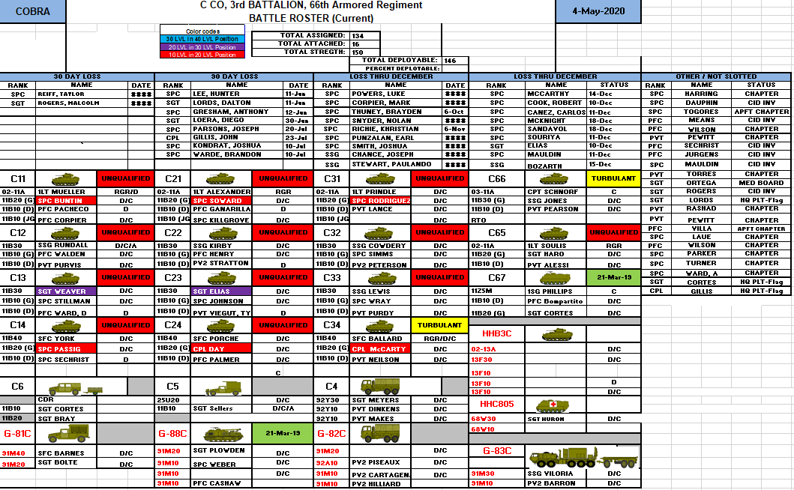
C/3-66 Crew Stability

Slide 45
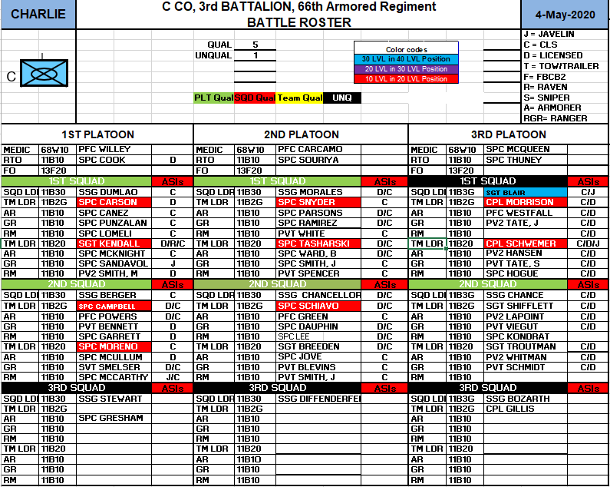
C/3-66 Crew Stability

Slide 46
Near Term Training Review
Gunslinger
(T+5 Approval)
(T+6 Concept)
24 Mar 20
Notes:
BN submit Mission Statement

Slide 47
Company METL Review
Mission Essential Task | End 2nd QTR OBJ-T | End 3rd QTR OBJ-T | End 4th QTR OBJ-T
Conduct Expeditionary Deployment Operations (10-CO-0056) Perform pre-deployment Supply Activities (10-CO-4804) Perform pre-deployment Maintenance Activities (43-CO-4805) Prepare personnel for Deployment for Companies (71-CO-004) Prepare Equipment for Deployment (55-CO-4806) Conduct Staging Activities (55-CO-4826) | T | T | T
Conduct Unit Defense (63-CO-0727) Implement CBRN Protective Measures (03-CO-9201) Employ camouflage, concealment, and deception techniques (05-CO-003) Treat and Evaluate Casualties (08-CO-003/ 08-CO-004) | P | T | T
Conduct Sustainment Support in an Area Defense (63-CO-1028) & Area Security (63-CO-1272) Provide Field Feeding Support (10-CO-0056) Conduct Bulk Petroleum Distribution Operations (10-CO-0237) Conduct Support Maintenance Operations (43-CO-0029) Conduct Logistics Package (LOGPAC) Support (63-CO-4565) Conduct Troop Leading Procedures (71-CO-5100) | T | T | T
Conduct Sustainment Support in an Movement to Contact (63-CO-1072) Provide Field Feeding Support (10-CO-0056) Conduct Bulk Petroleum Distribution Operations (10-CO-0237) Conduct Support Maintenance Operations (43-CO-0029) Conduct Logistics Package (LOGPAC) Support (63-CO-4565) Conduct Troop Leading Procedures (71-CO-5100) Conduct Unstabilized Gunnery (63-TS-2900) | P | T | T
Conduct Sustainment Support in an Attack (63-CO-1092) Provide Field Feeding Support (10-CO-0056) Conduct Bulk Petroleum Distribution Operations (10-CO-0237) Conduct Support Maintenance Operations (43-CO-0029) Conduct Logistics Package (LOGPAC) Support (63-CO-4565 Conduct Troop Leading Procedures (71-CO-5100) Conduct Unstabilized Gunnery (63-TS-2900) | P | T | T
Commander’s Notes
,
EUCOM RAF Redeployment, SRP
Redeployment Rail Operations
Camp Aachen Retrograde
Reestablish the footprint
STT: Employ Camouflage (3rd Quarter)
STT: Treat / Evacuate Casualties (3rd Quarter)
CL IIIB, Maintenance operations
Range Support: LOGPACs
HEAT Rollover
Weapons Qualification
CL IIIB, Maintenance operations
Range Support: LOGPACs
HEAT Rollover
Weapons Qualification
MMG Gunnery (3rd Quarter)
CL IIIB, Maintenance operations
Range Support: LOGPACs
HEAT Rollover
Weapons Qualification
MMG Gunnery (3rd Quarter)
COMMENTS:
By end of Q3 2020, we will see several Soldier reenlistment windows open and PCS moves, but remaining crews and leadership longevity whom conducted CbR XII will help offset these losses. All crews will recertify during 3rd Quarter gunnery. We will see multiple officer moves through July.

Slide 48
Gunslinger
T-1 Training Conducted
FSC Mission Essential Support (Maintenance, CLIIIB, DFAC Operations)
Gym in a Box container support
T-1 Training Not Conducted
NSTR
T-1 Training Conducted AAR
Issue: COVID19
Discussion: COVID19 has impacted normal support operations. To counter attack, the company implemented “minimal “mission essential manning” focusing on pacing items. As the COVID19 curve slowly flattens, we are adding focus to our non-pacer items (weapons, generators, wheeled vehicle services).
Recommendation: None at this time.
T+1 - T+5 Training Impacts
Training Support:
a) Static Range Support – M4, M240, M2 (T+1)
a) STAFFEX b) Static RNG Support –M17 (T+2)
a) Maintenance Terrain Walk - 4 June b) Co. M4 Range - 5 June (T+3)
a) Sergeant’s Time Training: Setup CP, Expando Van, FTCP & Employ Camouflage – 11 June b) Gunnery Table III c) Co. BBQ – 11 June (T+4)
a) Co. SFRG Meeting – 16 June b) Table IV Gunnery – 19 June (T+5)

Slide 49
T+6 For Approval
T+6 Wk 39 (21 - 27 JUN 20)
Resources
TBD
Event | Loc. | Aud. | DTG | METL
Table III, IV-VI, MMG Gunnery Support | TA 23, 24 DMPTR, DMPRC Range 18 | TBD | Table III: 10 -18 June Table IV-VI: 19 – 29 June MMG: 28 Jun – 02 Jul | METL 3, 4, 5
Focus of Leader Training:
Gunnery Support
Method: Golf Company provides tactical logistical support to Table III (TA 23/24), DOUTHIT Gunnery complex (DMPTR & DMPRC), and MMG (Range 18) IOT enable freedom of maneuver and line company certifications. Golf Company coordinates and synchronizes resupply through 101 BSB.
Endstate:
Leaders gain a better understanding of executing FSC support operations at the tactical level.
Issues/Concerns
N/A

Slide 50
Gunslinger Combat Proficiency
Units: | FSC |  |  |  | A FMT | B FMT | C FMT | FSC TOTAL
Weapons / Systems | #Assigned | # Qual. | # Req. | % | # Req. | # Req. | # Req. | # Req.
M4 | 94 | 59 | 94 | 63% | 12 | 12 | 10 | 129
M17 | 7 | 4 | 7 | 57% | 2 | 2 | 2 | 13
M249AR | 12 | 0 | 12 | 0% |  |  | 1 | 13
M320 | 4 | 0 | 4 | 0% |  |  |  | 4
Shotgun
Sniper Weapon Systems
Hand Grenades
Totals |  | 110 | 120 | 99%
Units: | FSC |  |  |  | A FMT | B FMT | C FMT | FSC TOTAL
Weapons / Systems | #Assigned | # Qual. | # Req. | % | # Req. | # Req. | # Req. | # Req.
M240B / L | 6 | 5 | 7 | 71% |  |  |  | 7
M2 | 10 | 8 | 10 | 80% | 2 | 2 | 2 | 16
M2HB
MK19 | 2 | 2 | 2 | 100% |  |  |  | 2
JAVELIN
Assault Breacher Vehicle (ABV)
Reconnaissance Vehicle, Motorized (Scout Truck)
Convoy Protection Platform (CPP) | 5 | 2 | 5 | 40% | 1 | 1 | 1 | 8
Mounted Machine Gun Platforms
120mm Mortars
APFT | Assigned | Passed | Failed | Due | Average
MAINT | 57 | 55 | 2 | 0 | 240
DISTRO | 28 | 26 | 2 | 0 | 245
FIELD FEEDING | 17 | 16 | 0 | 1 | 239
HQ | 9 | 9 | 0 | 1 | 251
FSC | 112 | 106 | 4 | 2 | 244
HT/WT | Assigned | Passed | Failed | Due
MAINT | 57 | 57 | 0 | 0
DISTRO | 28 | 28 | 0 | 0
FIELD FEEDING | 17 | 15 | 1 | 1
HQ | 9 | 9 | 0 | 0
FSC | 112 | 110 | 1 | 1

Slide 51
Gunslinger Vehicle Manning

Slide 52
Gunslinger Vehicle Manning

Slide 53
Near Term Training Review
Gunslinger
(T+5 Approval)
(T+6 Concept)
24 Mar 20
Notes:
BN submit Mission Statement

Slide 54
Company METL Review
Mission Essential Task | End 2nd QTR OBJ-T | End 3rd QTR OBJ-T | End 4th QTR OBJ-T
Conduct Expeditionary Deployment Operations (10-CO-0056) Perform pre-deployment Supply Activities (10-CO-4804) Perform pre-deployment Maintenance Activities (43-CO-4805) Prepare personnel for Deployment for Companies (71-CO-004) Prepare Equipment for Deployment (55-CO-4806) Conduct Staging Activities (55-CO-4826) | T | T | T
Conduct Unit Defense (63-CO-0727) Implement CBRN Protective Measures (03-CO-9201) Employ camouflage, concealment, and deception techniques (05-CO-003) Treat and Evaluate Casualties (08-CO-003/ 08-CO-004) | P | T | T
Conduct Sustainment Support in an Area Defense (63-CO-1028) & Area Security (63-CO-1272) Provide Field Feeding Support (10-CO-0056) Conduct Bulk Petroleum Distribution Operations (10-CO-0237) Conduct Support Maintenance Operations (43-CO-0029) Conduct Logistics Package (LOGPAC) Support (63-CO-4565) Conduct Troop Leading Procedures (71-CO-5100) | T | T | T
Conduct Sustainment Support in an Movement to Contact (63-CO-1072) Provide Field Feeding Support (10-CO-0056) Conduct Bulk Petroleum Distribution Operations (10-CO-0237) Conduct Support Maintenance Operations (43-CO-0029) Conduct Logistics Package (LOGPAC) Support (63-CO-4565) Conduct Troop Leading Procedures (71-CO-5100) Conduct Unstabilized Gunnery (63-TS-2900) | P | T | T
Conduct Sustainment Support in an Attack (63-CO-1092) Provide Field Feeding Support (10-CO-0056) Conduct Bulk Petroleum Distribution Operations (10-CO-0237) Conduct Support Maintenance Operations (43-CO-0029) Conduct Logistics Package (LOGPAC) Support (63-CO-4565 Conduct Troop Leading Procedures (71-CO-5100) Conduct Unstabilized Gunnery (63-TS-2900) | P | T | T
Commander’s Notes
,
EUCOM RAF Redeployment, SRP
Redeployment Rail Operations
Camp Aachen Retrograde
Reestablish the footprint
STT: Employ Camouflage (3rd Quarter)
STT: Treat / Evacuate Casualties (3rd Quarter)
CL IIIB, Maintenance operations
Range Support: LOGPACs
HEAT Rollover
Weapons Qualification
CL IIIB, Maintenance operations
Range Support: LOGPACs
HEAT Rollover
Weapons Qualification
MMG Gunnery (3rd Quarter)
CL IIIB, Maintenance operations
Range Support: LOGPACs
HEAT Rollover
Weapons Qualification
MMG Gunnery (3rd Quarter)
COMMENTS:
By end of Q3 2020, we will see several Soldier reenlistment windows open and PCS moves, but remaining crews and leadership longevity whom conducted CbR XII will help offset these losses. All crews will recertify during 3rd Quarter gunnery. We will see multiple officer moves through July.
POC: CPT Russell As of: 12May20

Slide 55
Gunslinger
T-1 Training Conducted
FSC Mission Essential Support (Maintenance, CLIIIB, DFAC Operations)
Gym in a Box container support
T-1 Training Not Conducted
NSTR
T-1 Training Conducted AAR
Issue: Douthit Gunnery Complex RECON
Discussion: Golf Company senior leaders conducted a Leaders RECON to Douthit Gunnery complex on 14 May, inspecting the kitchen facilities, barracks, motorpool, gaining access via Highway 77 North. Recommendation: Conduct another RECON with junior level leaders prior to Gunnery.
T+1 - T+5 Training Impacts
Training Support:
a) Static Range Support – M4, M240, M2 (T)
a) STAFFEX b) Static Range Support –M17 (T+1)
a) Maintenance Terrain Walk - 4 June b) Company M4 Range - 5 June (T+2)
a) Sergeant’s Time Training: Setup CP, Expando Van, FTCP & Employ Camouflage – 11 June b) Gunnery Table III c) Co. BBQ – 11 June (T+3)
a) Co. SFRG Meeting – 16 June b) Table IV Gunnery – 19 June (T+4)

Slide 56
T+6 For Approval
T+6 Wk 40 (28 JUN – 04 JUL 20)
Resources
TBD
Event | Loc. | Aud. | DTG | METL
Table III, IV-VI, MMG Gunnery Support | TA 23, 24 DMPTR, DMPRC Range 18 | TBD | Table III: 10 -18 June Table IV-VI: 19 – 29 June MMG: 28 Jun – 02 Jul | METL 3, 4, 5
Focus of Leader Training:
Gunnery Support, 4th of July Holiday Weekend
Method: Golf Company provides tactical logistical support to Table III (TA 23/24), DOUTHIT Gunnery complex (DMPTR & DMPRC), and MMG (Range 18) IOT enable freedom of maneuver and line company certifications. Golf Company coordinates and synchronizes resupply through 101 BSB.
Endstate:
Leaders gain a better understanding of executing FSC support operations at the tactical level.
Issues/Concerns
N/A

Slide 57
Gunslinger Combat Proficiency
Units: | FSC |  |  |  | A FMT | B FMT | C FMT | FSC TOTAL
Weapons / Systems | #Assigned | # Qual. | # Req. | % | # Req. | # Req. | # Req. | # Req.
M4 | 94 | 59 | 94 | 63% | 12 | 12 | 10 | 129
M17 | 7 | 4 | 7 | 57% | 2 | 2 | 2 | 13
M249AR | 12 | 7 | 12 | 60% |  |  | 1 | 13
M320 | 4 | 0 | 4 | 0% |  |  |  | 4
Shotgun
Sniper Weapon Systems
Hand Grenades
Totals |  | 110 | 120 | 99%
Units: | FSC |  |  |  | A FMT | B FMT | C FMT | FSC TOTAL
Weapons / Systems | #Assigned | # Qual. | # Req. | % | # Req. | # Req. | # Req. | # Req.
M240B / L | 6 | 5 | 7 | 71% |  |  |  | 7
M2 | 10 | 8 | 10 | 80% | 2 | 2 | 2 | 16
M2HB
MK19 | 2 | 2 | 2 | 100% |  |  |  | 2
JAVELIN
Assault Breacher Vehicle (ABV)
Reconnaissance Vehicle, Motorized (Scout Truck)
Convoy Protection Platform (CPP) | 5 | 2 | 5 | 40% | 1 | 1 | 1 | 8
Mounted Machine Gun Platforms
120mm Mortars
APFT | Assigned | Passed | Failed | Due | Average
MAINT | 57 | 55 | 2 | 0 | 240
DISTRO | 28 | 26 | 2 | 0 | 245
FIELD FEEDING | 17 | 16 | 0 | 1 | 239
HQ | 9 | 9 | 0 | 1 | 251
FSC | 112 | 106 | 4 | 2 | 244
HT/WT | Assigned | Passed | Failed | Due
MAINT | 57 | 57 | 0 | 0
DISTRO | 28 | 28 | 0 | 0
FIELD FEEDING | 17 | 15 | 1 | 1
HQ | 9 | 9 | 0 | 0
FSC | 112 | 110 | 1 | 1

Slide 58
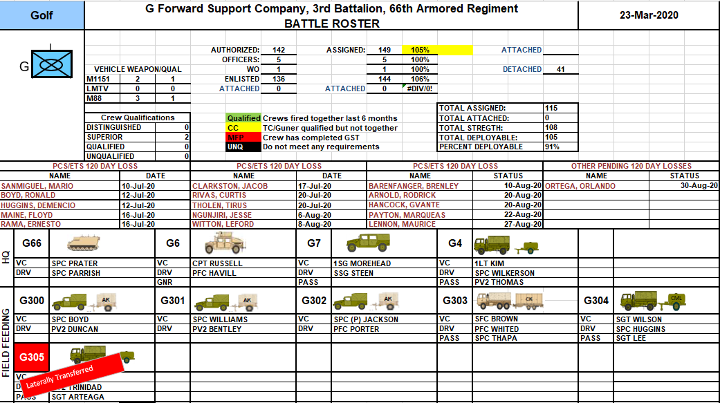
Gunslinger Vehicle Manning

Slide 59
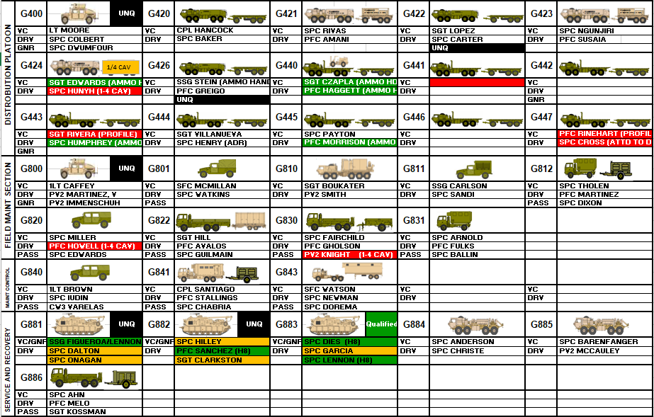
Gunslinger Vehicle Manning

Slide 60
Stretch Goals
Burt’s Knights
Stretch Goals
POC- CPT Tyler Kellogg, BN AS3
Tyler.j.Kellogg.mil@mail.mil
As of 12MAY20
Notes:
BN submit Mission Statement

Slide 61
Personnel Readiness Stretch Goals
Task | 3-66 AR | HHC | A Co | B Co | C Co | G Co
98% of Soldiers correctly slotted in eMILPO (15MAY) | 100% | 100% | 100% | 100% | 100% | 85%
100% of deployed Soldiers have correct AEA code in eMILPO (15MAY) | 100% | 100% | 100% | 100% | 100% | 100%
Commanders review, update, and certify 100% UCFRs (15MAY) | 90% | 100% | 100% | 100% | 100% | 100%
100% coding of KD, Crew, MG, and aviators (15MAY) | 100% | 100% | 100% | 100% | 100% | 50%
All soldiers in window of retention eligibility counseled by BN CDR/ CSM (15JUN) | 100% | 100% | 100% | 100% | 100% | 100%
Units complete 100% of home visits (15JUL) | 20% | 0% | 0% | 0% | 100% | 60%
Valid meal entitlement codes applied to 100% of CACs (15JUL) | 95% | 94% | 95% | 100% | 98% | 99%
100% of all Soldiers complete SRP (minus hearing) (15JUL) | 100% | 100% | 100% | 100% | 100% | 100%
Legend
eMILPO | <90% | 90-98% | >98%
Home Visits | <75% | 75-99% | 100%
MEC to CAC | <90% | 90-99% | 100%
SRP | <90% | 90-99% | 100%
Current percentages sent by S1 / Company input.
Cadillac Don’t Look Back!
Unclassified
POC- CPT Tyler Kellogg, BN AS3
Tyler.j.Kellogg.mil@mail.mil
As of 19MAY20
- CADILLAC DON’T LOOK BACK! -
POC: CPT Brown As of: 16JAN20
UNCLASSIFIED/FOUO
POC: CPT Brown As of: 16JAN20

Slide 62
Supply and Equipment Stretch Goals
Task | 3-66 AR | HHC | A Co | B Co | C Co | G Co
Identify excess equipment on property book & request disposition instructions in DST (15MAY) | 61% | 75% | 75% | 80% | 50% | 25%
Class VIII 100% uploaded into M3PT (15JUN) | 100% | 100%
Class VIII Durables & Non-expendables 90% uploaded into GCCS-A (15JUN) | 95% | 95%
Update M3PT with CLVIII to 100% fill of each MES/DES set (15JUN) | 100% | 100%
Provide BCT S4 copies of revised final signed BN CSDP (Supply) SOPs (15JUL) BCT S4 provides G4 final signed BCT & BN CSDP (Supply) SOPs | 100%
Pacers are associated with sub-systems within G-Army (15JUN) | 35% | 0% | 0% | 25% | 100% | 75%
BBPCT on hand for PTDO/IRF units (15JUN) | 5% | 0% | 0% | 0% | 0% | 25%
SSA metrics- within FORSCOM goals (ZPARK, PGI, PGR) (15JUL) | 70% | 100% |  | 75% | 100% | 75%
Identify shortages required to meet 10/20 standard and provide prioritized list of shortages to S4 & S8 (15JUL) | 80% | 100% | 100% | 75% | 50% | 75%
Update service plans in G-Army (15MAY) | 100% | 100% | 100% | 100% | 100% | 100%
Services on training calendars (15MAY) | 98% | 90% | 100% | 100% | 100% | 100%
Services up to date for pacing items (15JUN) | 90% | 70% | 100% | 100% | 79% | 100%
Reduce SSL zero balance by correctly coding in GCSS-A (15MAY) | 80% | 100% | 100% | 100% | 0% | 100%
SSL ordered for zero balance & additional lines (15JUN) | 80% | 100% | 100% | 100% | 0% | 100%
Conduct a virtual maintenance terrain walk w/DCO-M (15JUN) | 2JUN |  |  | 80%
Update G-Army to 100% Medical Device (MD)/MD Systems with maintenance plan & system number (15JUN) | 100%
Provide BCT S4 copies of final signed BN CMDP (Maintenance) SOPs (15JUL) BCT S4 provides G4 final BCT & BN CMDP SOPs | DRAFT With S4
Legend
CLVIII im M3PT | <75% | 75-99% | 100%
CLVIII in G-Army | <75% | 75-90% | >90%
CSDP SOP | No Draft | Draft with S4 | Revision Complete
Cadillac Don’t Look Back!
Unclassified
POC- CPT Tyler Kellogg, BN AS3
Tyler.j.Kellogg.mil@mail.mil
As of 19MAY20
- CADILLAC DON’T LOOK BACK! -
POC: CPT Brown As of: 16JAN20
UNCLASSIFIED/FOUO
POC: CPT Brown As of: 16JAN20

Slide 63
Training Readiness Stretch Goals
Task |  | 3-66 AR | HHC | A Co | B Co | C Co | G Co
Online AR 350-1 Training Complete for: | OPSEC (15MAY) | 59% | 90% | 51% | 23% | 100% | 33%
 | Information Assurance (15MAY) | 55% | 90% | 24% | 29% | 100% | 33%
 | Anti-terrorism (15MAY) | 56% | 90% | 31% | 28% | 100% | 33%
 | INFOSEC (15MAY) | 54% | 90% | 44% | 29% | 75% | 33%
 | TARP (15MAY) | 74% | 90% | 51% | 100% | 100% | 33%
 | Suicide Prevention (15JUN) | 89% | 90% | 75% | 100% | 100% | 80%
 | SHARP (15MAY) | 95% | 100% | 95% | 100% | 100% | 80%
 | Equal Opportunity (15JUN) | 95% | 100% | 94% | 100% | 100% | 80%
 | Resiliency (15JUN) | 91% | 100% | 75% | 100% | 100% | 80%
Achieve 100% CCO and TCAIMS-II appointments (15MAY) |  | 91% | 100% | 100% | 100% | 50% | 80%
UMO & HAZMAT appointments and certifications uploaded |  | 79% | 100% | 100% | 100% | 67% | 100%
68W Inpatient & Infection Control Training Complete (15MAY) |  | 11% | 11%
100% DTMS Records Updated (WPNs, HT/WT, APFT, SHARP) (15MAY) |  | 86% | 100% | 100% | 100% | 84% | 50%
100% Range Safety/ OIC requirements filled (15JUN) |  | 50% | 100% | 75% | 75% | Need to update BC sig. | 70%
>90% IRF GST and GT I&II complete (15JUN) |  | 18JUN | 50% |  |  | 0% | 0%
All crews through gates to LFX in BATS/ AGTS in preparation for live gunnery tables (15JUL) |  | 18JUN | 100% |  | 28% | 0% | 0%
Begin Crew LFX Tables (15JUL) |  | 18JUN |  |  | 28% | 0% | 0%
1ID PTDO Units and IRF Units SQD/Section STX (live or virtual) (15JUN) |  | 2JUL |  |  |  | 0% | 0%
Begin to execute platoon-level field training (15JUL) [4 QTR Training Plan] |  | 15JUL |  |  | 0% | 0% | 0%
Utilize CCTT for SEC/ PLT/ CO/ BN TNG (15JUL) |  | 15JUL |  |  | 0% | 0% | 0%
Validate all FM/TACSAT/HF systems functional (Executed during DG2 COMMEX 25MAY-5JUN) |  | 25MAY | 30% |  | 0% | 0% | 0%
Provide BCT Master Driver copies of final signed drivers training SOPs (15JUL) (BCT Master Driver will provide G4 SOPs) |  | 50%
Legend
350-1 | <75% | 75-99% | 100%
IRF GT I/II | <80% | 80-90% | >90%
BATS/AGTS | <90% | 90-99% | 100%
CCTT | PLT level TNG | CO-level TNG | BN-level TNG
Drivers SOP | No Draft | Draft w/G4 | Revision complete
Cadillac Don’t Look Back!
Unclassified
POC- CPT Tyler Kellogg, BN AS3
Tyler.j.Kellogg.mil@mail.mil
As of 19MAY20
- CADILLAC DON’T LOOK BACK! -
POC: CPT Brown As of: 16JAN20
UNCLASSIFIED/FOUO
POC: CPT Brown As of: 16JAN20

Slide 64
Training Review
Burt’s Knights
(T+7 – T+12 Near Term)
POC- CPT Tyler Kellogg, BN AS3
Tyler.j.Kellogg.mil@mail.mil
As of 4MAY20
Notes:
BN submit Mission Statement

Slide 65
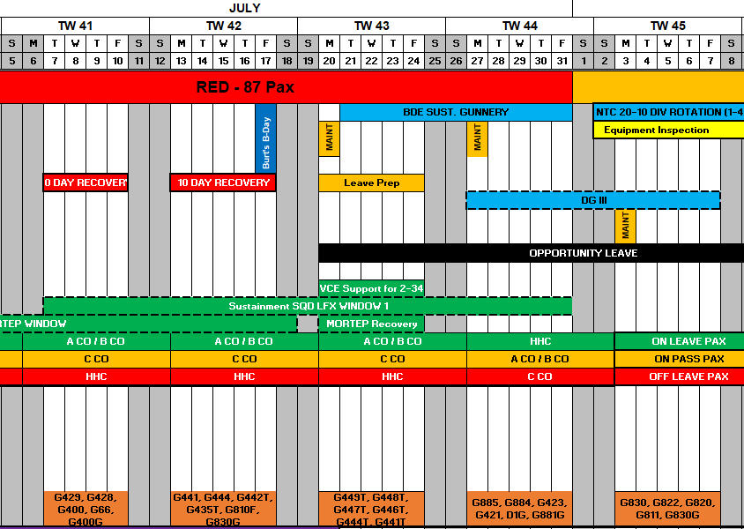
T+7 – T+11
POC- CPT Tyler Kellogg, BN AS3
Tyler.j.Kellogg.mil@mail.mil
As of 18MAY20

Slide 66
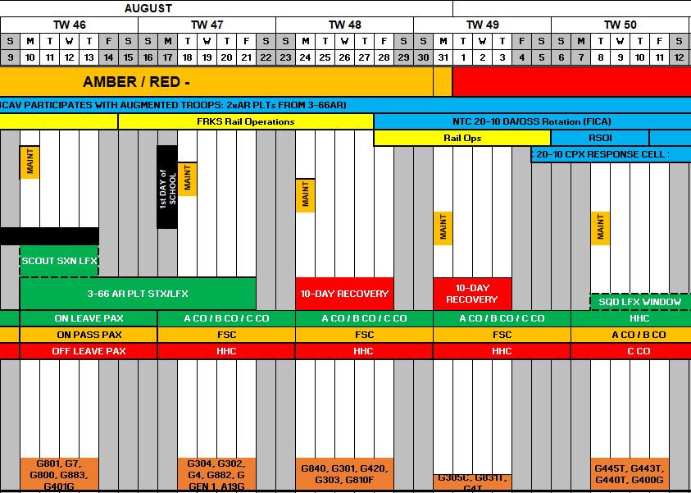
T+12 – T+16
POC- CPT Tyler Kellogg, BN AS3
Tyler.j.Kellogg.mil@mail.mil
As of 18MAY20
POC- CPT Tyler Kellogg, BN AS3
Tyler.j.Kellogg.mil@mail.mil
As of 30MAR20

Slide 67
Focus Area by Week
UNCLASSIFIED/FOUO
Week 1 Communication
Battalion Retrans – 1 x Vehicle Battalion TOC – 4 x Vehicles Battalion TAC – 3 x Vehicles CTCP – 1 x Vehicle
CO CPs – 3 x M113 / 2x HMMWVs
BN CMD Group CO CMD Group 12 x Platoons
9 x Squads (MBTRs/Harris)
Week 2 CBRN
Deploy, establish, and test Battalion Chemical Alarms
Clean
PMCS
BII/COIE Inventory
Validate Faults or Deficiencies
Parts O/O
− Layout and inspect personal CBRN equipment
Week 3
Week 4 Tentage
Establish the Battalion TOC in Battalion Motorpool
Establish the CTCP
Establish Company CPs in Motorpool
Weapons/Optics/NVGS
Clean
PMCS/BII Inventory
Validate Faults or Deficiencies
Parts O/O
Equipment Turned
In/Shipped for Repair
Tie-Down IAW BN Standard
Containers
Open containers
MILVANS
ISU-90s
TRICONS
SSL
Inspect paperwork
Clean
Inspect
Inventory Shop Stock
Sign for SSL in G Army
Promask
JSLIST
Overboots
Gloves
Canteens w/caps
Camelback with adapter
OCIE
Soldier Readiness
Clean
PMCS
BII/COIE Inventory
PRIM Radios
Validate Faults or Deficiencies
Parts O/O
Equipment Turned In/Shipped for Repair
…
SGLI
DD93
Monthly Counseling
Medical Readiness
Dental
Hearing
PHA
Annual Physical
Vision
POW
Wills
Finance / LES Review Dog Tags
Full Soldier Layout at PLT
Level
Clothing Record Signed by Soldier and PSG
Soldier goes to CIF to requisition shortfalls
List of shortfalls after CIF submitted to CSM
Plows and Rollers Plows – 3 w/ A CO & 3 w/ B CO Rollers – 2 - Clean
PMCS
BII/COIE Inventory
- Parts O/O
Deployment Equipment / Systems
Layout Shackles
UMO Books
Hazmat Paperwork
Gun tube cables
Blocking / Bracing Material
Wrapping supplies
One time locks
‐
POC- CPT Tyler Kellogg, BN AS3
Tyler.j.Kellogg.mil@mail.mil
As of 4MAY20

Slide 68
Schools

Slide 69
SCHEDULED CDDP TRAINING
SCHEDULED
PENDING
UMO
COMPANY | WARFIGHTER NAME | START DATE | END DATE | RESERVATION STATUS
HHC | ATKINSON MICHAEL CURTIS | 13-Jul-20 | 24-Jul-20 | VALID RESERVATION
A CO | BARTON TYLER JAMES | 13-Jul-20 | 24-Jul-20 | VALID RESERVATION
HHC | DOTSON MICHAEL J | 13-Jul-20 | 24-Jul-20 | VALID RESERVATION
HHC | GRIFFITH CHARLES ARTHUR | 13-Jul-20 | 24-Jul-20 | VALID RESERVATION
A CO | KOCHENDERFER STACEY ALLEN | 13-Jul-20 | 24-Jul-20 | VALID RESERVATION
A CO | UNDERWOOD CLOYCE | 13-Jul-20 | 24-Jul-20 | VALID RESERVATION
G CO | MCMILLAN, CHRISTOPHER C, | 18-Aug-20 | 28-Aug-20 | VALID RESERVATION
G CO | STEIN, ZACHARY B | 18-Aug-20 | 28-Aug-20 | VALID RESERVATION
TC-AIMS
G CO | MCMILLAN, CHRISTOPHER C, | 27-Jul-20 | 31-Jul-20 | VALID RESERVATION
G CO | STEIN, ZACHARY B | 27-Jul-20 | 31-Jul-20 | VALID RESERVATION
HAZMAT
G CO | LOPEZ GONZALEZ | 15-Jun-20 | 26-Jun-20 | VALID RESERVATION
HHC | BYRD JOSEPH LEONARD | 27-Jul-20 | 7-Aug-20 | VALID RESERVATION
HHC | HAMMONDS BILLY MACK | 27-Jul-20 | 7-Aug-20 | VALID RESERVATION
HHC | KERR COLIN A | 27-Jul-20 | 7-Aug-20 | VALID RESERVATION
RAIL/AIR LOAD TEAM
HHC | CHAVEZ SEAN LUCIANO | 26-May-20 | 28-May-20 | VALID RESERVATION
HHC | GREN GABRIEL PAUL | 26-May-20 | 28-May-20 | VALID RESERVATION
HHC | HARRELL ANDREW GAGE | 26-May-20 | 28-May-20 | VALID RESERVATION
HHC | HESTER GLADYS MARY | 26-May-20 | 28-May-20 | VALID RESERVATION
HHC | OATES AUSTIN LAINE | 26-May-20 | 28-May-20 | VALID RESERVATION
ICODES/ALCP
N/A | N/A | N/A | N/A
CONTAINER CONTROL
A CO | KILMETE, HARVEY | 18-May-20 | 20-May-20 | VALID RESERVATION
A CO | MCGOVERN, LAUREN | 18-May-20 | 20-May-20 | VALID RESERVATION
G CO | STEIN, ZACHARY | 18-May-20 | 20-May-20 | VALID RESERVATION
G CO | GREEN, COREY | 18-May-20 | 20-May-20 | VALID RESERVATION
B CO | WELLER, WYATT | 18-May-20 | 20-May-20 | VALID RESERVATION
C CO | MORALESSERANO, FELIX | 18-May-20 | 20-May-20 | VALID RESERVATION
C CO | BERGER, JACOB | 18-May-20 | 20-May-20 | VALID RESERVATION
C CO | LEWIS, KEITH | 18-May-20 | 20-May-20 | VALID RESERVATION
HHC | WHITLOCK, ZACHARY | 18-May-20 | 20-May-20 | VALID RESERVATION
UMO
COMPANY | WARFIGHTER NAME | START DATE | END DATE | RESERVATION STATUS
HHC | WHITLOCK, ZACHARY | 1-Jun-20 | 12-June-20 | FR-28 Submitted
HHC | TAYLOR, JONATHAN | 1-Jun-20 | 12-Jun-20 | FR-28 Submitted
HHC | KELLS, EVEN | 1-Jun-20 | 12-Jun-20 | FR-28 Submitted
HHC | DUNLAP, SAMUEL | 1-Jun-20 | 12-Jun-20 | FR-28 Submitted
TC-AIMS
n/a | n/a | n/a | n/a | n/a
HAZMAT
C CO | SHIFFLETT, NICHOLAS | 15-Jun-20 | 26-Jun-20 | FR-28 Submitted
C CO | KENDALL, MATTHEW | 15-Jun-20 | 26-Jun-20 | FR-28 Submitted
C CO | BREEDEN, ALEXANDER | 15-Jun-20 | 26-Jun-20 | FR-28 Submitted
C CO | BERGER, JACOB | 13-Jul-20 | 24-Jul-20 | FR-28 Submitted
C CO | ELIAS, ABRAN | 13-Jul-20 | 24-Jul-20 | FR-28 Submitted
HHC | KELLS, EVAN | 13-Jul-20 | 24-Jul-20 | FR-28 Submitted
HHC | KIM, HYUNSOO | 13-Jul-20 | 24-Jul-20 | FR-28 Submitted
HHC | HERNANDEZ, MARK | 13-Jul-20 | 24-Jul-20 | FR-28 Submitted
HHC | PHAM, THINH | 13-Jul-20 | 24-Jul-20 | FR-28 Submitted
HHC | WALFORD, BRANDON | 13-Jul-20 | 24-Jul-20 | FR-28 Submitted
C CO | CHANCELLOR, MARCUS | 10-Aug-20 | 21-Aug-20 | FR-28 Submitted
C CO | HAROAGUILAR, ROBERTO | 10-Aug-20 | 21-Aug-20 | FR-28 Submitted
RAIL/AIR LOAD TEAM
N/A | N/A | N/A | N/A | N/A
ICODES/ALCP
HHC | SHELLEY, CAMERON | 20-Jul-20 | 30-Jul-20 | PACKET SUBMITTED TO DIV
HHC | KIM, HYUNSOO | 20-Jul-20 | 30-Jul-20 | PACKET SUBMITTED TO DIV
HHC | BLACKWELL, HARMON | 20-Jul-20 | 30-Jul-20 | PACKET SUBMITTED TO DIV
CONTAINER CONTROL
N/A | N/A | N/A | N/A | N/A

Slide 70
NCOES Tracker
Basic Leaders Course
Unit | Grade | Warfighter | MOS | Course Title | Start Date | End Date | APFT | DTS | PKT | REMARKS
WJZBT0 | E4 | HALFTOWN CONNOR | 11C | BASIC LEADER COURSE | 13 APR | 8MAY |  | N/A |  | GRADUATED
WJZBA0 | E4 | FOLLEY JAKOB WILLIAM | 19K | BASIC LEADER COURSE | 13 APR | 8 MAY |  | N/A |  | GRADUATED
WJA1G0 | E4 | ANDERSON ZACHARY | 91B | BASIC LEADER COURSE | 13 APR | 8 MAY |  | N/A |  | GRADUATED
WJA1G0 | E4 | PRATER MICHAEL WAYNE | 91H | BASIC LEADER COURSE | 13 APR | 8 MAY |  | N/A |  | GRADUATED
WJZBT0 | E4 | ROWLAND ANTHONY MICHEAL | 68W | BASIC LEADER COURSE | 29 APR | 21 MAY |  | N/A |  | CURRENTLY ATTENDING (DL)
WJZBT0 | E4 | BROWN BARRETT NELSON | 68W | BASIC LEADER COURSE | 29 APR | 21 MAY |  | N/A |  | CURRENTLY ATTENDING (DL)
Advanced Leaders Course
Unit | Grade | Warfighter | MOS | Course Title | Start Date | End Date | APFT | DTS | PKT | REMARKS
WJZBC0 | E5 | HARINGBRITO DEVIN JAMES | 25U | ALC | 11-May-2020 | 30-Jun-2020 |  |  |  | CANCELLED RESERVATION/RESCHEDULED
WJZBT0 | E5 | ALCAZAR NOEMI LUCIDO | 68W | ALC | 26-May-2020 | 30-Jun-2020 |  |  |  | CANCELLED RESERVATION/RESCHEDULED
WJZBT0 | E5 | BYRD JOSEPH LEONARD | 35F | ALC | 01-Jun-2020 | 21-Jul-2020 |  |  |  | CANCELLED RESERVATION/RESCHEDULED
WJZBB0 | E5 | SCOTT ALICIA ANNE | 25U | ALC | 01-Jun-2020 | 21-Jul-2020 |  |  |  | CANCELLED RESERVATION/RESCHEDULED
WJA1G0 | E5 | CASTILLOCASTANON KENN | 91A | ALC | 8-Jul-20 | 25-Sept-20 |  |  |  | CANCELLED RESERVATION/RESCHEDULED
Senior Leaders Course
Unit | Grade | Warfighter | MOS | Course Title | Start Date | End Date | APFT | DTS | PKT | REMARKS
WJZBT0 | E6 | RUSSELL THOMAS PHILLIP V | 19K | MANEUVER SLC | 07-Jul-20 | 25-Aug-20 |  |  |  | CANCELLED RESERVATION
WJA1G0 | E6 | SHELBY GARY LEWIS | 92G | CULINARY SPECIALIST SLC | 12-Jul-20 | 14-Aug-20 |  |  |  | CANCELLED RESERVATION

Slide 71
Master Gunner
Unit | Grade | Warfighter | MOS | Course Title | Start Date | End Date | DTS | PKT | REMARKS
WJZBB0 | E5 | Skaggs, Matthew |  | Abrams Master Gunner |  |  |  |  | PACKET PENDING
WJZBA0 | E5 | Smith, Chadwick |  | Abrams Master Gunner |  |  |  |  | PACKET PENDING
WJZBC0 | E6 | Jones, Andre |  | Bradley Master Gunner |  |  |  |  | PACKET PENDING
WJZBC0 | E6 | Cowdery, Jonathan |  | Bradley Master Gunner |  |  |  |  | PACKET PENDING
WJZBT0 | E6 | Kells, Evan |  | Bradley Master Gunner |  |  |  |  | PACKET PENDING
WJZBT0 | E5 | Clark, Spencer |  | Bradley Master Gunner |  |  |  |  | PACKET PENDING
Ranger
Unit | Grade | Warfighter | MOS | Course Title | Start Date | End Date | PHY | RPFT | DTS | PKT | REMARKS
WJZBC0 | O2 | Soulis, Andrew | 11B | Ranger | 17-Jan-2020 | 20-May-2020 |  |  |  |  | SM Graduate Ranger/ Attempting to walk on to Airborne
Sniper
Unit | Grade | Warfighter | MOS | Course Title | Start Date | End Date | APFT | DTS | PKT | REMARKS
N/A | N/A | N/A | N/A | N/A | N/A | N/A | N/A | N/A | N/A | N/A
Master Fitness
Unit | Grade | Warfighter | MOS | Course Title | Start Date | End Date | APFT | DTS | PKT | REMARKS
WJZBT0 | E5 | Cuthrell, Ericsson | 25U | Master Fitness Trainer | N/A | N/A | N/A | N/A | N/A | No Scheduled Courses until Jan 2021
WJZBT0 | E6 | Amerson, Nicholas | 68W | Master Fitness Trainer | N/A | N//A | N/A | N/A | N/A | No Scheduled Courses unit Jan 2021

Slide 72
Drill School
Unit | Grade | Warfighter | MOS | Course Title | Start Date | End Date | APFT | DTS | PKT | REMARKS
WJZBB0 | E6 | RUSSELL, THOMAS PHILLIP, V | 19K | DRILL SERGEANT | 04-May-2020 | 16-May2020 |  |  |  | Completed Phase 1
WJZBC0 | E6 | DIFFENDERFER TYLER JAMES | 11B | DRILL SERGEANT | 18-May-2020 | 30-May-2020 |  |  |  | PHASE 1 (DL)
Recruiter
Unit | Grade | Warfighter | MOS | Course Title | Start Date | End Date | APFT | DTS | PKT | REMARKS
WJA1G0 | E5 | WILSON KAYLA MICHELLE ARDO | 92G | RECRUITER | 11-May-2020 | 26-Jun-2020 |  |  |  | Cancelled Reservation/Rescheduled for 20JUL20
POC:
SFC Roche Zayas, Alberto
Cell: 360-359-5535
Office: 785-239-8004
Alberto.j.rochezayas.mil@mail.mil

Slide 73
Delinquent Vouchers
Last Name | First Name | Departure Date | RETURN | Amount of Authorization | Unit | Remarks
N/A | N/A | N/A | N/A | N/A | N/A | N/A
GTC
UNIT | Account Name | Current Balance | Past Due Amount | 30 Day Past Due | 60 Day Past Due | 90 Day Past Due | 120 Day Past Due | 150 Days Past Due | 180+ Days Past Due | Remarks
WJZBB0 | DONALDSON,ADAM | 612.17 | 612.17 | 612.17 | 0.00 | 0.00 | 0.00 | 0.00 | 0.00
WJZBA0 | KNOX,CLARENCE | 6999.04 | 103.04 | 103.04 | 0.00 | 0.00 | 0.00 | 0.00 | 0.00 | No longer in Army. Contacted and he denied that he made charges. Told him to dispute charges. Card Shut Down.

Slide 74
Alibis
Alibis:
Companies (In Sequence)
Staff (In Sequence)
Final Comments:
Burt 37
Burt 3
Burt 5
Burt 7
Burt 6
POC- CPT Tyler Kellogg, BN AS3
Tyler.j.Kellogg.mil@mail.mil
As of 4MAY20

